Slide 1


General health economics slides
Mark Jit^{1,2,3}
¹London School of Hygiene & Tropical Medicine
²Modelling and Economics Unit, Public Health England
³School of Public Health, University of Hong Kong
I have no conflicts of interest to declare.

Slide 2
Outline
At the end of this session you should:
Understand the motivation for conducting economic evaluations of infectious disease interventions.
Understand the basic methods used to measure costs and benefits of infectious disease interventions.
Understand the advantages and limitations of different types of economic evaluations of infectious disease interventions.

Slide 3
Key concepts
Scarcity
Health care resources (money, staff time, hospital beds etc.) are limited and insufficient to meet all health care demand.
Opportunity cost
The cost of a choice (eg. purchasing a vaccine) is measured in terms of the value of best alternative foregone (eg. using the same money to build a new hospital). This is called the opportunity cost of the choice.
Notes:
3

Slide 4


Why does economics matter?
Opportunity cost
The cost of a choice is measured in terms of the value of best alternative foregone.
Influenza vaccine
Influenza vaccine
“Every pound can only be spent once. If we spend it unwisely, on costs that cannot be justified, then we risk harming other people whose care will be adversely affected.”
David Haslam
Chair of NICE
World Health Assembly, 2014
HPV vaccine
New school
Immunisation budget
Public sector budget
Choices like this are being made all the time.
Health economics helps to make the trade-offs explicit.

Slide 5
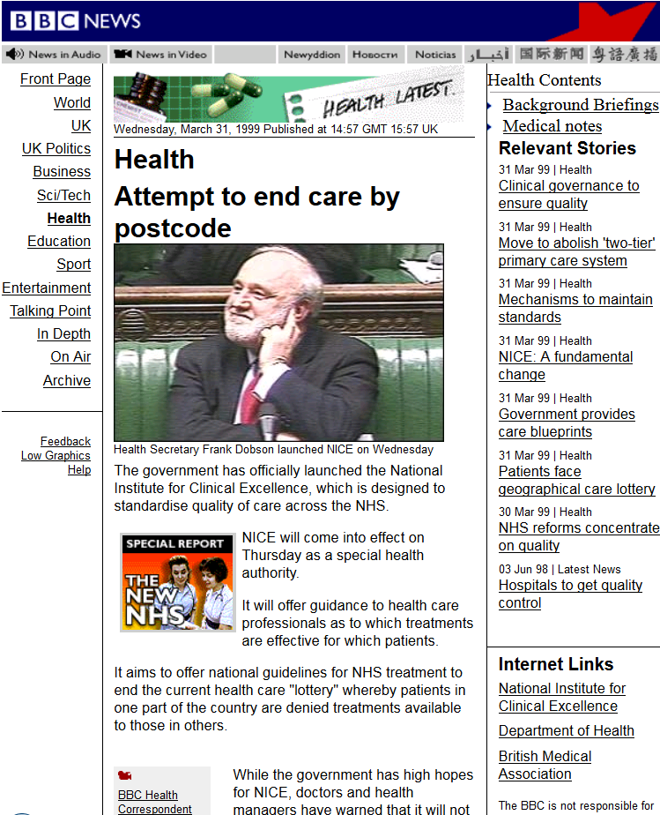
Rationing
Rationing (or “priority setting”) is the mechanism we use to allocate scarce resources. Some ways to ration:
Implicit – Allocation limited by supply, but criteria by which decisions are made not explicit (eg. “postcode lottery”).
Price – Willingness (and ability) to pay determines allocation (eg. auctioning, free market).
Waiting lists – Willingness (and ability) to wait determines allocation.
Needs – Evaluation of needs (based on explicit criteria such as maximising health or ensuring equity of health gains) determines allocation. E.g. NHS Constitution (2015): “most effective, fair and sustainable use of finite resources”.

Slide 6
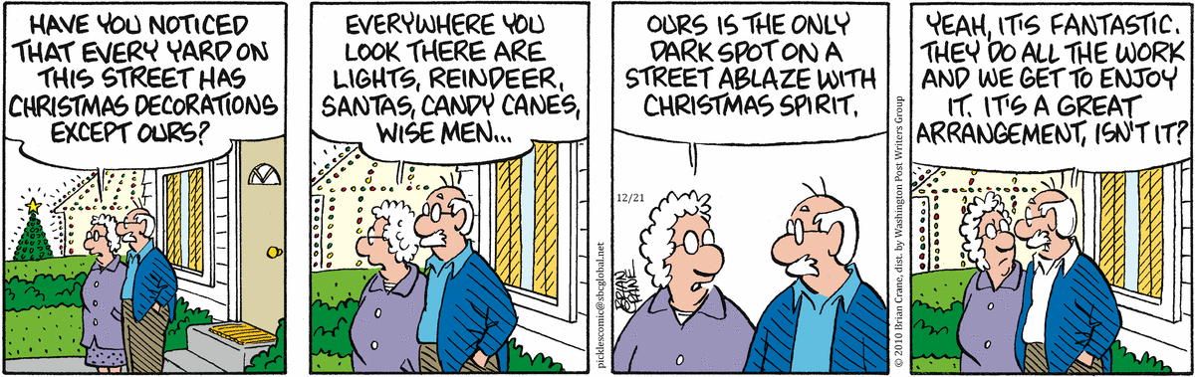
Key concepts: externalities
Externalities are costs and benefits borne by someone other than the person producing or consuming something.
© Brian Crane, dist. by The Washington Post Writers Group - All Rights Reserved.
Consumption of vaccination
Other people are protected from disease (“herd protection”)
Other people are happier knowing that someone is protected from disease (“caring externality”)
Vaccine prices may fall for everyone due to economies of scale
Notes:
6

Slide 7
Assessing a new technology
Some criteria considered by health technology agencies:
Safety
Efficacy
Burden of disease
Sustainability
Value for money
Equity
Quality
Affordability
Feasibility
Acceptability
Ethical issues
Clinical criteria
Economic criteria
Social criteria

Slide 8




How health technologies are assessed in the UK
Manufacturer licensure information
Cost-effectiveness model from manufacturer
National Institute for Health and Care Excellence (NICE) considers evidence
Assessment from Evidence Review Group
Other submissions (clinicians, patients etc.)
Cost-effectiveness below £20,000-£30,000/QALY?
Drug approved, must be funded
Drug not approved, usually not funded (up to Clinical Commissioning Group)

Slide 9

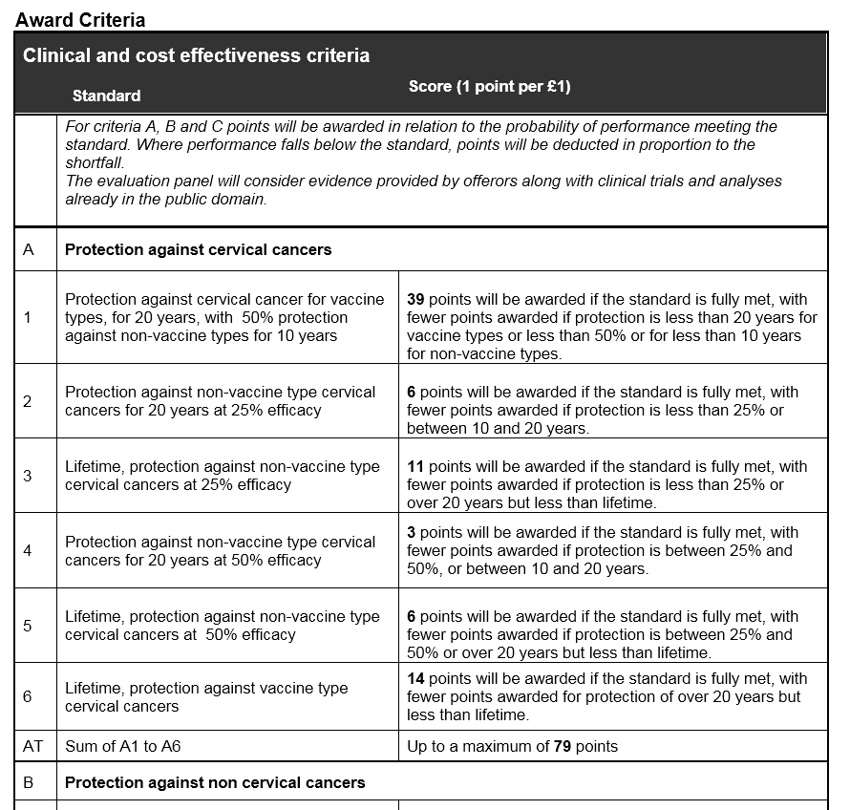
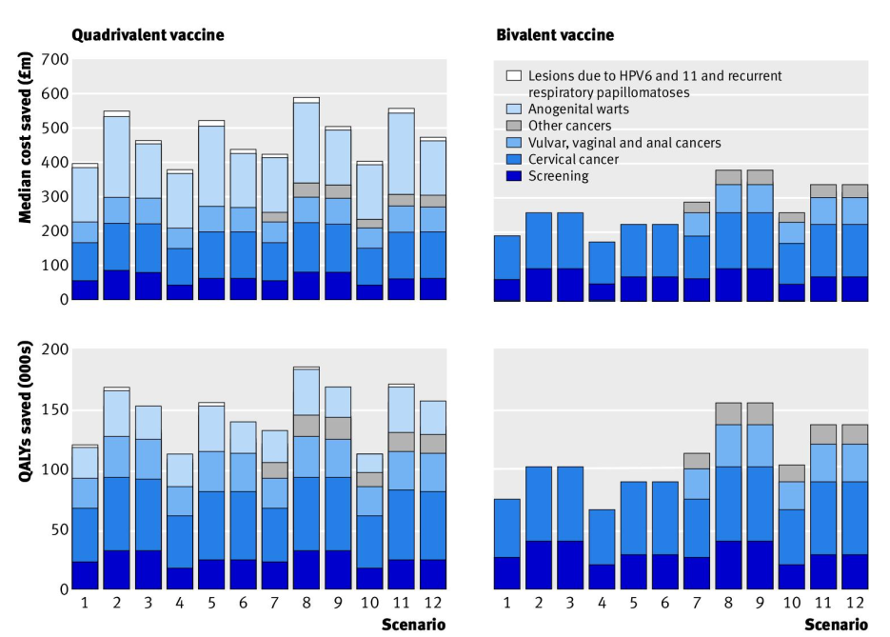
Using economic modelling to drive competitive tendering
Invitation to offer for the supply of Human Papillomavirus Vaccine. Offer ref number: CM/PHV/11/5245.
https://data.gov.uk/data/contracts-finder-archive/contract/216771/
Jit et al. BMJ 2011;343:d5775

Slide 10
Decision making around the world
HIGH INCOME COUNTRIES | LOW INCOME COUNTRIES
Funding from national budgets. | Funding from external agencies (eg. Gavi) and co-payments from national budget.
Decision making usually by Ministry of Health advised by NITAG and/oor other expert committees. | Decision making usually by Ministry of Finance.
Strong existing local expertise and framework for complex modelling and health economic evaluation. | Growing local expertise and framework for complex modelling and health economic evaluation.
Main purpose of health care spending is to improve health in line with social values of the population (intrinsic value of health). | Improved health is an end in itself but also a means towards development goals such as economic growth (instrumental value of health).
COUNTRIES IN TRANSITION
(MIDDLE INCOME)

Slide 11
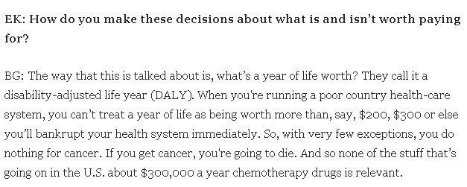

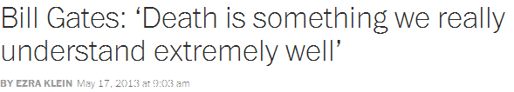
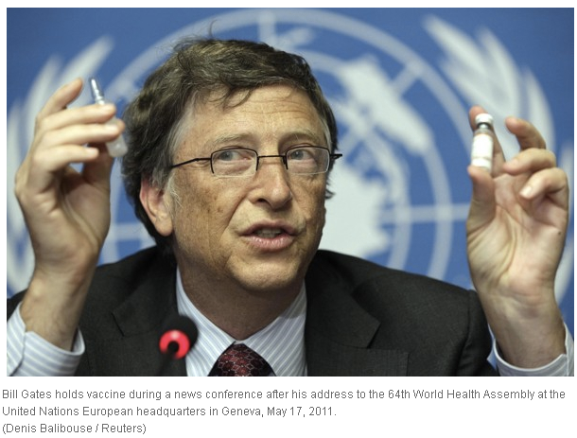
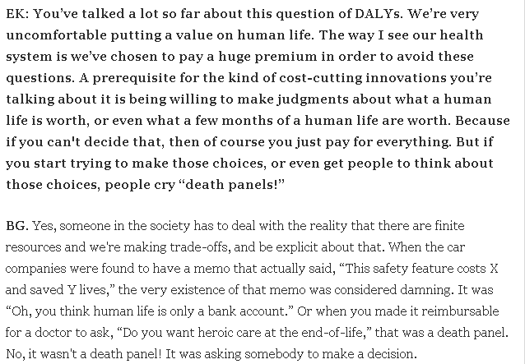
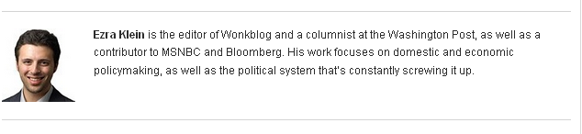
Economics in global health decision making

Slide 12
What economic tool to use?
Sustainability
Vaccination will prevent 100 deaths a year after 2040.
Value for money
“Vaccination costs $10,000 per death prevented.”
Price setting
“The break even price of vaccination is $20 a dose.”
Affordability
“The cost of vaccine delivery is $15 per vaccinated girl.”
“Vaccination costs $2 million a year, but will save the public sector $500,000 a year.”
Impact on disease
Costing study
Budget impact analysis
Epidemiological model
Full economic evaluation
Threshold price analysis

Slide 13
The convergence of two narratives is economic evaluation
A (full) economic evaluation compares the incremental costs and consequences of an intervention compared to a comparator
COST OF VACCIN-ATING
COST OF ILLNESS
HEALTH BURDEN
HEALTH BURDEN
COST OF ILLNESS
NO VACCINE
VACCINE

Slide 14
Cost-effectiveness analysis
Incremental costs
Incremental cost-effectiveness ratio
=
Incremental health gains
COST OF VACCIN-ATING
COST OF ILLNESS
-
COST OF ILLLNESS
=
HEALTH IMPACT
Measured in quantities like:
episodes of disease prevented
life years gained
QALYs gained
DALYs averted
HEALTH IMPACT
-
VACCINE
NO VACCINE

Slide 15
Cost effectiveness thresholds
Country | Decision making body | Outcome measure | Willingness to pay for a QALY or DALY
Australia | Pharmaceutical Benefits Advisory Committee (PBAC) | QALY | A$50,000¹
Ireland | Department of Health & Health Service Executive | QALY | €45,000²
Nether-lands | Health Care Insurance Board (CVZ) | QALY | €20,000-€80,000³
UK | National Institute for Health and Care Excellence (NICE) | QALY | £20,000 - £30,000⁴
USA | Preventive Services Task Force (PSTF) | QALY | $50,000 - $100,000⁵
Thailand | Health Intervention and Technology Assessment Program | QALY | Bt160,000⁶
Global | Commission on Macroeconomics and Health | DALY | 1-3 x GDP per capita⁷
¹Lopert et al. Commonwealth Fund Pub 2009; 1297(60):1; Harris et al. Med Decis Making 2008; 28:713; ²IPHA DOE & HSC. 2012. Framework Agreement; ³Boersma et al. Value in Health 2010; 13:853; ⁴Guide to the methods of technology appraisal. NICE, 2013; ⁵Ubel et al. Arch Intern Med 2003; 163:1637-1641; ⁶Teerawattananon et al. Z. Evidenz, Fortbildung und Qualität im Gesundheitswesen 2014; 108:397–404; ⁷Newall et al. Pharmacoeconomics 2014; 32:525.

Slide 16
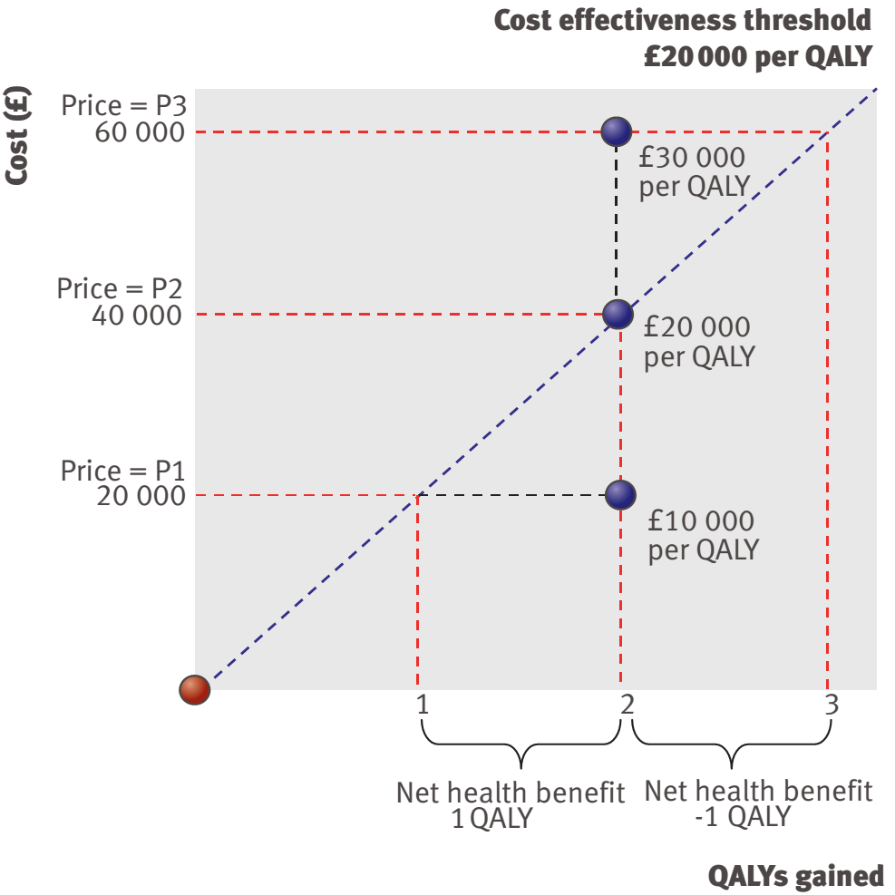
Cost effectiveness thresholds
Claxton et al. BMJ 2008; 336: 251.

Slide 17
The cost-effectiveness plane
Incremental costs
Cost-effectiveness threshold
Intervention is not cost-effective
Intervention is dominated by comparator
Intervention is cost-effective
Incremental consequences
Intervention is not cost-effective
Intervention dominates comparator
Intervention is cost-effective

Slide 18
Measuring costs
 | DIRECT (FINANCIAL) COSTS | INDIRECT (ECONOMIC) COSTS
Definition | Cost involving an identifiable monetary transaction. | Opportunity costs with actual money not necessarily changing hands .
Use | Budgeting, financial planning. | Economic evaluation.
Examples | Purchase of vaccines Purchase of vans to transport vaccines Commissions or per diems for vaccine staff | Value of cold chain space Value of staff time and unpaid volunteer time to deliver vaccines

Slide 19
Measuring costs: who pays?
 | Direct costs | Indirect costs
Health care provider perspective | Vaccine procurement and delivery Health care used to treat illness (drugs, staff, facilities etc.) | Unrelated future medical costs: lifetime health care costs from prevented deaths (note: controversial!)
Household perspective | Out-of-pocket expenses for care and medicines Transport and subsistence to seek health care Informal care | Loss of income from time off work due to own or others’ sickness Cost of borrowing or asset sales to cover catastrophic health expenditures
Societal perspective | All of the above | All of the above Macroeconomic impact of disease

Slide 20
Direct and indirect costs of influenza
Productivity loss due to lost days of work for patients and caregivers
Transport, accommodation for caregivers
Hospital stay, prescribed medications and examinations, self-medication
Yang et al. Infect Dis Poverty 2015; 4:44.
Notes:
rm(list = ls(all = TRUE))
cost=matrix(c(
70,26,59,
1038,277,197), nrow=3)
colnames(cost)=c("Outpatient","Inpatient")
rownames(cost)=c("Direct medical","Direct non-medical","Indirect")
barplot(cost, legend=T, args.legend=list(x=1,bty="n"),
ylab="Cost (2013 USD)", col=c("red","green","blue"))
title(main="Economic costs of influenza in China")
box()

Slide 21

Measuring benefits: life and its quality
“Health is a state of complete physical, mental and social well-being and not merely the absence of disease or infirmity.”
- Preamble to the Constitution of the World Health Organization, 1946
Healthy life years lost
(disregards years lived which aren’t in perfect health)
Quality adjusted life years lost
Years of life lost
(disregards health of those years)

Slide 22
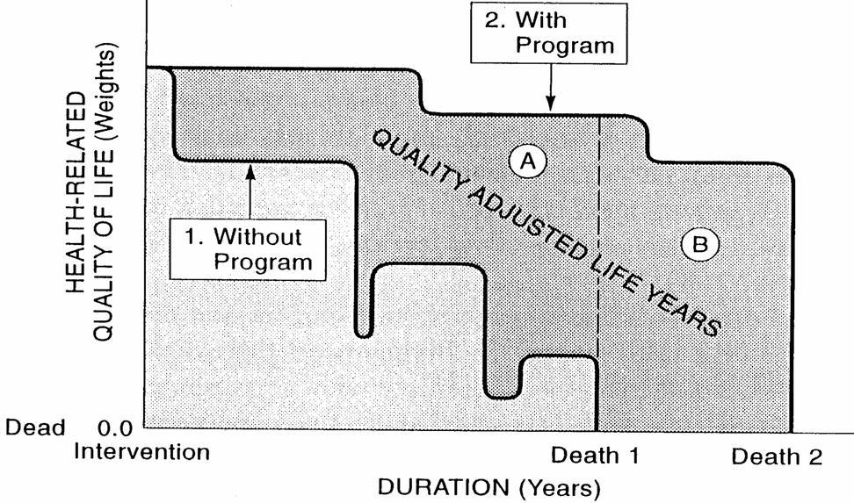
Measuring benefits: QALYs
(DALYs work in a similar way)
Gold et al. Cost-effectiveness in health and medicine. OUP, 1996.
Notes:
22

Slide 23
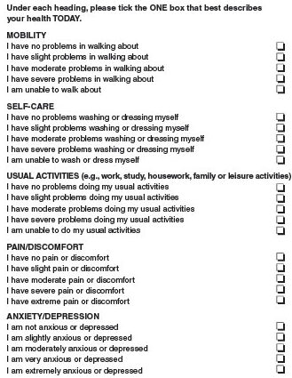
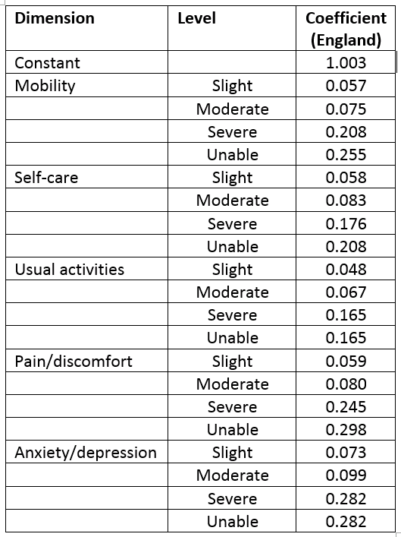
Generic instruments to measure QALYs
http://www.euroqol.org/eq-5d-products/eq-5d-5l.html

Slide 24
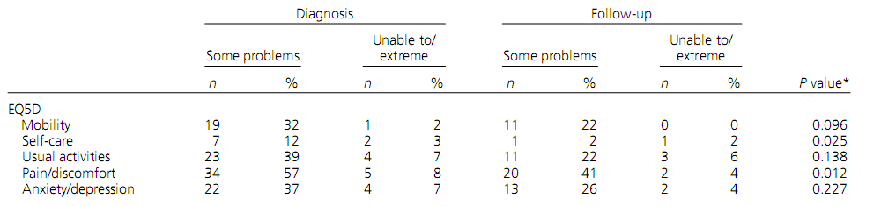
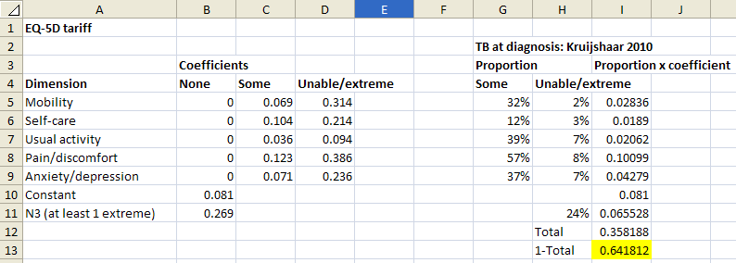
Generic instruments to measure QALYs
Example: Quality of life of tuberculosis patients at diagnosis and follow-up
Kruijshaar et al. Int J Tuberc Lung Dis 14:296.

Slide 25
Discounting
Imagine a world with no inflation...
If I owe you £1000, would you rather I paid you back today or in 10 years time?

Slide 26



Discounting
Imagine a world with no inflation...
If I owe you £1000, would you rather I paid you back today or in 10 years time?
2010
2015
2020
Economists call this change in the value of money over time “discounting”

Slide 27
Discounting
Why discount?
HM Treasury sets out a discount rate of 3.5% for public sector bodies based on:
Pure time preference – we are impatient and prefer good things now rather than later.
Catastrophic risk – something may happen in the future that will radically alter our ability to benefit from an investments.
Diminishing returns – we will be richer and live longer in the future, so the same amount extra will be worth less.
HM Treasury. (2014). The Green Book: appraisal and evaluation in central government.

Slide 28
Discounting
Discounting formula
Y_{n} = discounted value in year n
X_{n} = undiscounted value in year n
r = discount rate
Country | Discount rate: costs | Discount rate: effects
Mexico | 5% | 5%
Netherlands | 4% | 1.5%
Thailand | 3% | 3%
South Africa | 5% | 5%
UK | 3.5% | 3.5%
USA | 3% | 3%

Slide 29
Discounting
The present value of money
x(0) = Present value of money today
x(t) = Present value of money in year t
r = discount rate
Notes:
x=rep(0,100)
for(i in 1:100) x[i]=1/(1+3.5/100)^i
par(lwd=4, ps=20)
plot(x, type="l", xlab="Time (years)", ylab="Value")

Slide 30
Economic evaluations alongside trials
Incorporating economic outcomes in a clinical trial is complex and should be done in consultation with a health economist familiar with the clinical/public health area.

Slide 31
Economic evaluations alongside trials
Limitations of trial-based economic evaluations
Long-term outcomes beyond the follow-up period of the trial are not captured.
Community-level externalities (such as herd immunity for infectious disease interventions) are not captured.
Trial population may be unrepresentative of actual population.
Trial conditions may not be representative of use of intervention in the real world
May not be feasible to explore all possible options or combinations of interventions.
An alternative (or complementary) method is to use model-based economic evaluations.

Slide 32
Model-based economic evaluations
No disease
No vaccination
Illness
Disease
C₁
H₁
Death
C₂
H₂
No disease
Vaccination
C_{v}
Illness
Disease
C₃
H₃
Cost implications
Health implications
Death
C₄
H₄
Incremental cost-effectiveness ratio
(C₁ + C₂) – (C_{v} + C₃ + C₄)
=
(H₁ + H₂) – (H₃ + H₄)

Slide 33
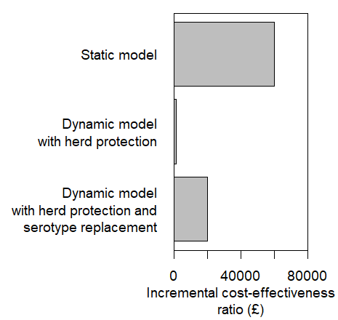
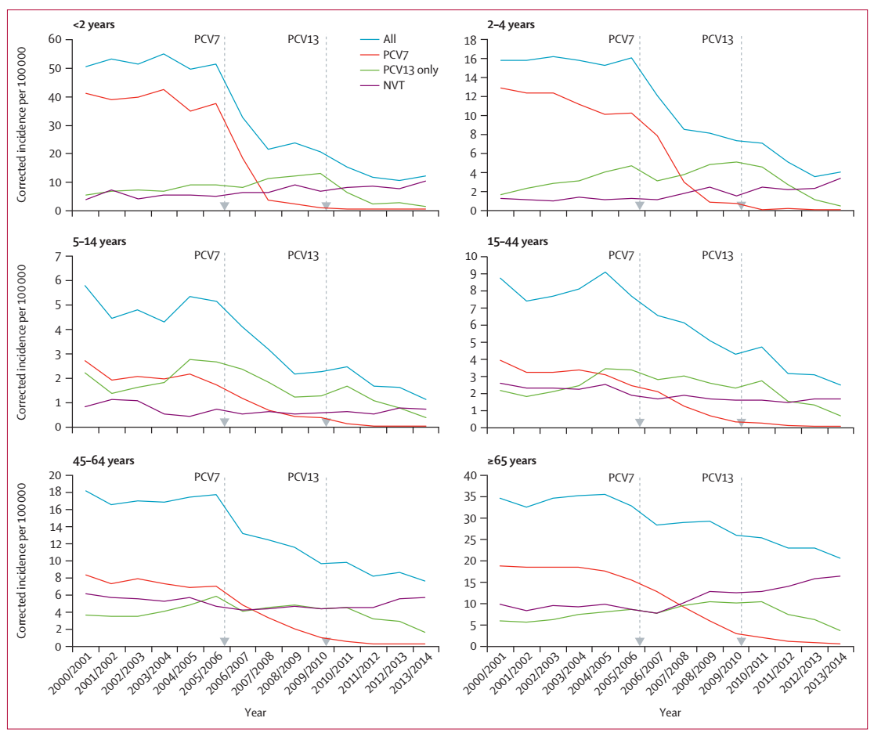
Herd effects and cost-effectivenses
Invasive pneumococcal disease in England & Wales (2000/1 - 2013/14)
Corrected for case ascertainment trend up to 2009/10
Cost-effectiveness of PCV-7 introduction in England & Wales
Melegaro et al. Vaccine 2004; 22: 4203 Van Hoek et al. Vaccine 2012; 30:7205
Waight et al. Lancet Inf Dis 2015; 15:629.
Notes:
pcv.cea=matrix(c(
"Static model",60000,
"Dynamic model\nwith herd protection",1000,
"Dynamic model\nwith herd protection and\nserotype replacement",20000),
ncol=2, byrow=T)
pcv.cea=pcv.cea[nrow(pcv.cea):1,]
par(mai=c(1,2.5,1,1), cex=1.2)
barplot(height=as.numeric(pcv.cea[,2]), names.arg=pcv.cea[,1],
horiz=T, las=1, xlim=c(0,80000),
xlab="Incremental cost-effectiveness\nratio (£)")
box()

Slide 34
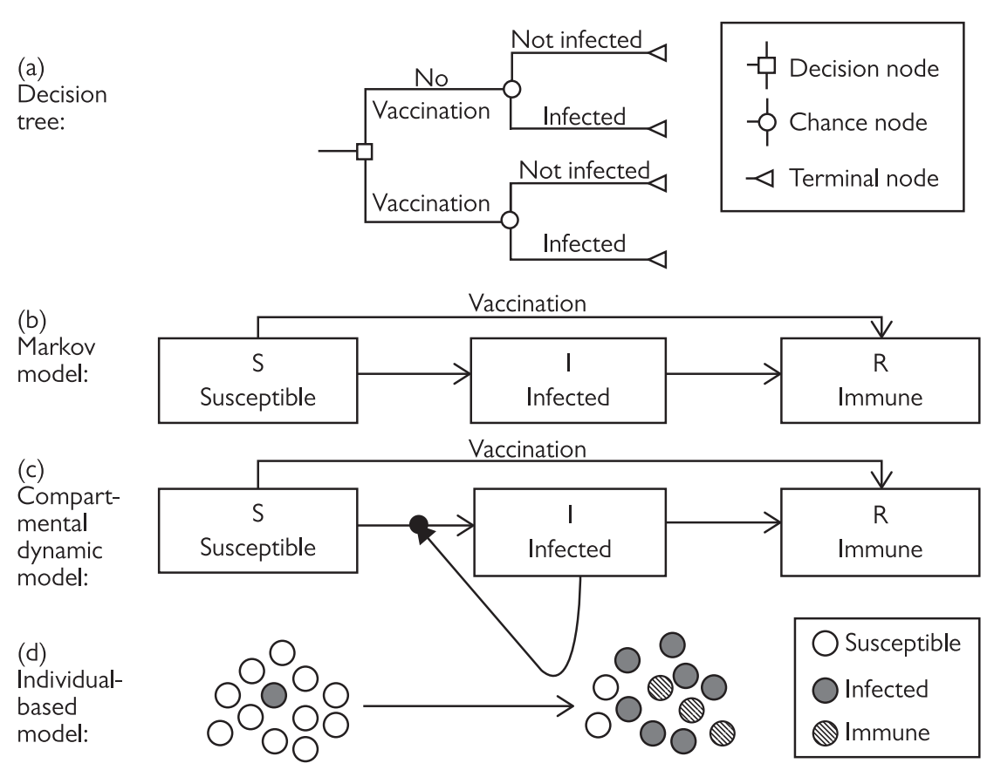
Models of vaccination
Static models
Dynamic models
Jit and White. Chapter 17: Economic analysis of interventions against infectious diseases. In: Oxford Specialist Handbook of Infectious Disease Epidemiology. OUP: Oxford, 2015.

Slide 35
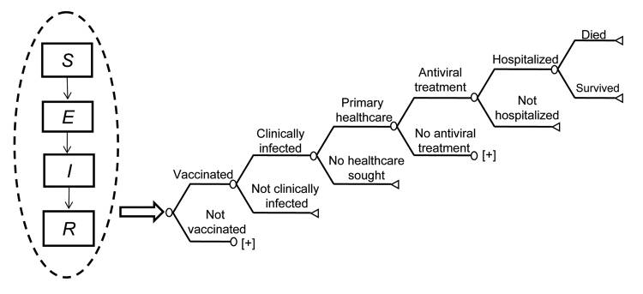
Incorporating economic outcomes into dynamic models
S
Susceptible
E
Latent
I
Infected
R
Recovered
Adapted from Newall et al. Emerg Inf Dis 2010; 16:224.

Slide 36
Static or dynamic?
Jit and Brisson. Pharmacoeconomics 2011; 29:371.

Slide 37
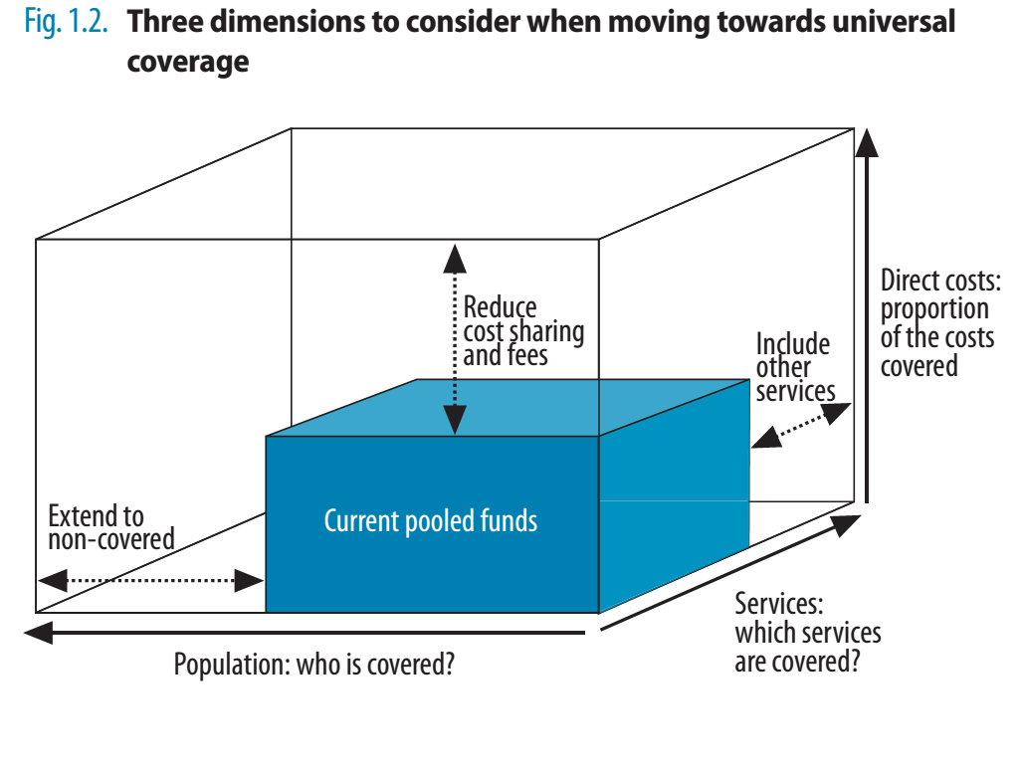

Economics of universal health coverage
World health report 2010. Health systems financing: the path to universal health coverage.

Slide 38
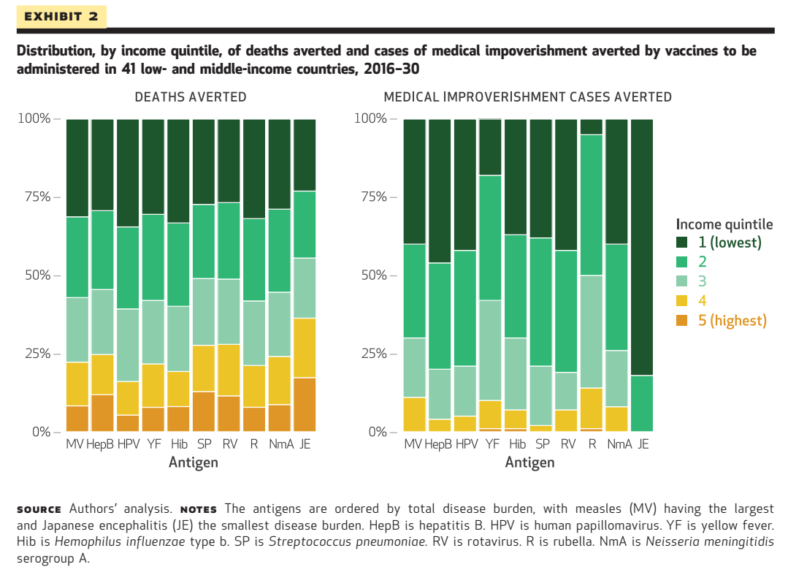
Equity: vaccine impact by income quintile
Chang et al. Health Affairs 2018; 37:2.

Slide 39
Key messages
Health economic evaluation is used to ensure that resource allocation decisions are made on explicit, evidence-based and needs-based criteria.
Economic evaluation of infectious disease interventions is a specialised field which requires analysts familiar with both health economics as well as the special epidemiological features of vaccine-preventable diseases.
It is important to understand the assumptions and limitations behind different types of economic models as these can have a large impact on model results.

Slide 40
Further reading
General text on economic evaluation:
Drummond MF, Sculpher MJ, Claxton K, Stoddard DL, Torrance GW. (2015). Methods for the economic evaluation of health care programmes. 4th edition. OUP.
Economic evaluations of infectious disease interventions:
Beutels P, Scuffham PA, MacIntyre CR. Funding of drugs: do vaccines warrant a different approach? Lancet Infect Dis 2008; 8:727.
Brisson M, Edmunds WJ. Economic evaluation of vaccination programs: the impact of herd immunity. Med Decis Making. 2003 Jan-Feb;23(1):76-82.
Jit M, Brisson M. Modelling the Epidemiology of Infectious Diseases for Decision Analysis: A Primer. Pharmacoeconomics 2011; 29:371.
Jit M, White PG. Chapter 17: Economic analysis of interventions against infectious diseases. In: Oxford Specialist Handbook of Infectious Disease Epidemiology. OUP: Oxford, 2015.

